Slide 1
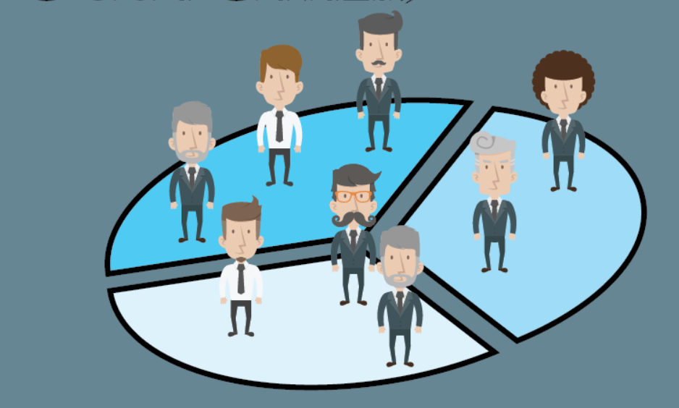
CUSTOMER SEGMENTATION
ANALYSIS USING K-MEANS
CLUSTERING

Slide 2
contents
Introduction
Dataset description
Problem statement
Main aim
Literature review
Definitions
Methodlogy
Oservations
Result
Conclusion
references

Slide 3
INTRODUCTION
Customer Segmentation is the process of dividing the customer into distinct groups based on common characteristics.
By understanding each cluster , companies can improve marketing efforts, products, and services to deliver a more personalized and effective experience.
This segmentation process helps to create targeted marketing campaigns, such as offering exclusive discounts to frequent shoppers or promoting specific products etc.
Customer segmentation is not a one-time activity but rather an ongoing process that requires continuous monitoring and adjustment

Slide 4
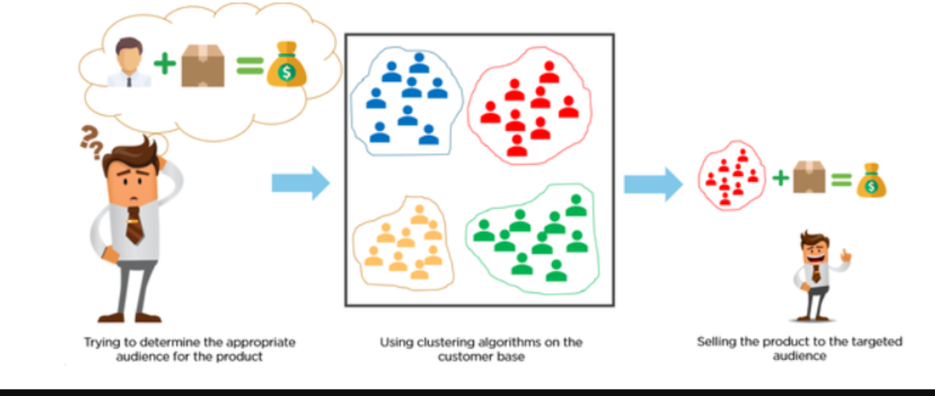

Slide 5
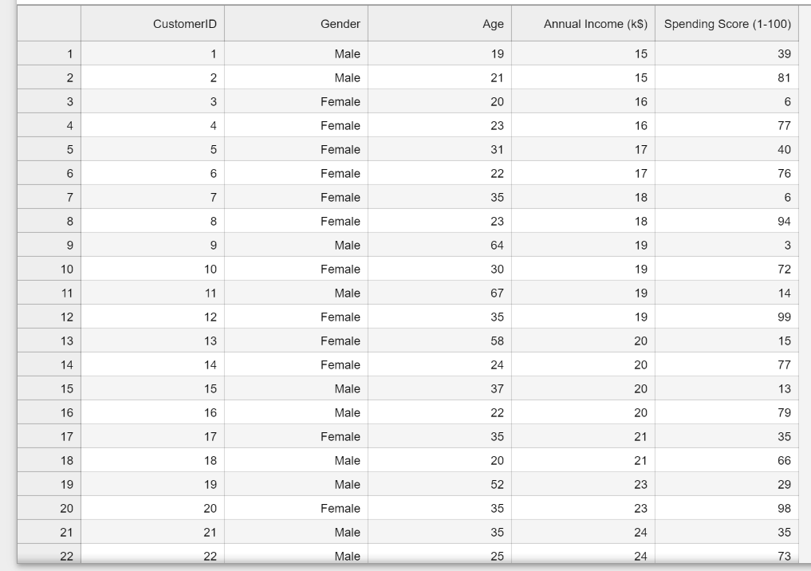
DATASET DESCRIPTION
The dataset name is Mall_Customer.csv consists of 5 columns which are
CustomerID
Gender
Age
Annual Income(k$)
Spending Score (1-100)
Where Gender is a categorical value and rest all features are numeric.

Slide 6
PROBLEM STATEMENT
Suppose we own a supermarket mall. Through membership cards we get some details of mall customers. So our problem statement is to understand the customers like who can be easily be the Target Customers so that the sense can be given to marketing team and plan the strategy accordingly.

Slide 7
MAIN AIM
By the end of this case study , we would be able to answer below questions.
How to achieve customer segmentation using machine learning algorithm (K-Means Clustering) in Python in simplest way.
Who are your target customers with whom you can start marketing strategy (easy to converse)
How the marketing strategy works in real world.

Slide 8
LITERATURE REVIEW
Name Of The Author | Title Name | Journal Name
Sari Juni Nurma, Nugroho , Lukito. Edi , Ferdiana, Ridi & Santosa , P. Insap | Review on Customer Segmentation Technique on Ecommerce (2016). | Advanced Science Letters
Chenguang Wang | Efficient Customer Segmentation in digital marketing using Deep Learning with Swarm Intelligence Approach (2022). | Information Processing and Management.
Rahma Wah Sembring Brahama, Fahd Agodzo Mohammed, Kankamol Chairuong | (2020)Customer Segmentation based on RFM model using K-Means , K-Medoids and DBSCAN methods (2020). | Lontar Komputer Jurnal Ilmiah Teknology Informasi

Slide 9
Eman Hussein .Sharaf Addin , Novia Admodisastro , Siti Nur Syahirah , M.Ashri , Azrina Kamaruddin Yew C. Chong(2022). | Customer Mobile Behavioural Segmentation and Analysis in Telecom Using Machine Learning(2022) . | Applied Artificial Intelligence
M. A. Syakar , B. K. Khotimah , EMS Rochman , B. D. Satoto | Integration K-Means Clustering Method and Elbow Method for identification of the best customer profile cluster(2018). | IOP Conference Series: Materials Science and Engineering
Mediana Aryuni , Evaristus Didik Madyatmadja , Eka Miranda | Customer Segmentation in XYZ Bank using K-Means and K-Meiods Clustering(2018). | International Conference on Information Management and Technology(ITCM Tech)

Slide 10
DEFINITIONS
Machine Learning
Machine learning (ML) is a branch of artificial intelligence that allows computers to learn from and make decisions based on data without being explicitly programmed. It uses algorithms to find patterns in data, enabling predictions or decisions without human intervention. There are 3 types of ML : Supervised, Unsupervised, Reinforcement Learning.
Clustering
Clustering is a machine learning technique used to group similar data points into clusters. It is an unsupervised learning method, meaning that it works on unlabeled data.
Elbow Method
The Elbow Method is used to determine the optimal number of clusters (K) for K-means clustering. By plotting WCSS values for different values of K, the "elbow point" is identified, where adding more clusters does not significantly decrease WCSS. This point suggests the best number of clusters for the data.

Slide 11
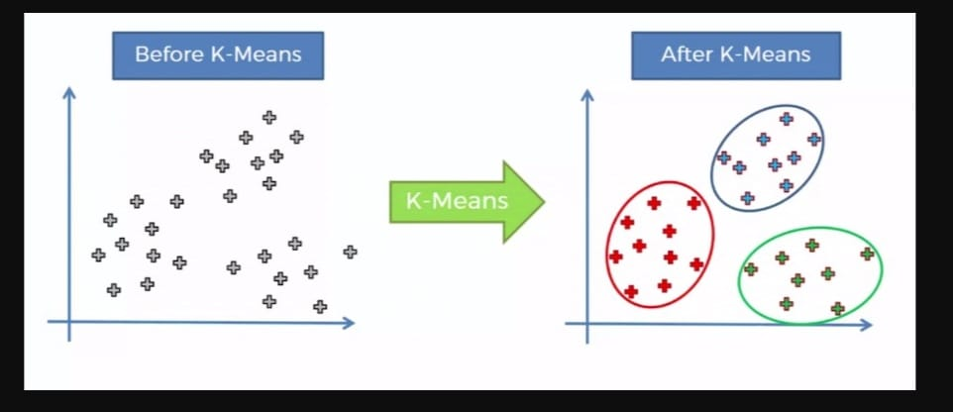
k–Means algorithm
K Means algorithm in an iterative algorithm that tries to partition the dataset into K predefined distinct non overlapping sub groups which are called as cluster. Here K is the total no of clusters. Every point belongs to only one cluster. Clusters cannot overlap.
The goal is to minimize the Within-Cluster Sum of Squares (WCSS), which is the sum of squared distances between each data point and its centroid. The algorithm continues until it converges to the most compact and distinct clusters.
In this project, the K-means algorithm was used
to segment customers into distinct groups based
on their attributes, such as spending behavior
and preferences.

Slide 12

WCSS (Within-Cluster Sum of Squares)
WCSS is a measure used in clustering to calculate the sum of the squared distances between each data point and its corresponding centroid within a cluster. It is an important metric to evaluate the compactness of clusters. Lower WCSS values indicate that the clusters are more tightly packed. Mathematically, WCSS is expressed as:
WCSS = $\sum_{i=1}^{k}{\sum_{x∈C_{i}}{{\left\|x−μ\right\|}^{2}}}$
k is number of clusters.
$C_{i}$ is the $i^{th}$ cluster
x denotes the data points in cluster $C_{i}$
$μ_{i }$is the centroid of cluster $C_{i}$
${ IIx − μII}^{2}$ is the squared Euclidean distance between x and $μ_{i }$.

Slide 13
METHODLOGY

Slide 14
Step 1: DATA COLLECTION
As metioned above we use the dataset Mall_Customers for this project. We took this dataset from the Kaggle website .
Step 2 : INSTALLING LIBRARIES
For this we need certain libraries such as pandas , numpy ,seaborn ,
matplotlib etc . We first install these libraries using “pip” command. i .e
! pip install pandas numpy seaborn matplotlib
Step 3 : IMPORTING LIBRARIES
After installing the required libraries we import it into to notebook for analysis. It also import some other libraries for better conclusions

Slide 15
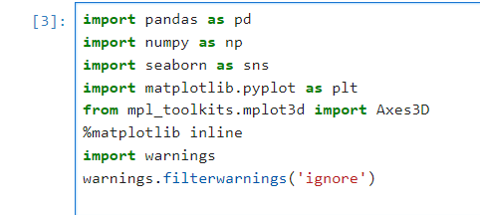
mpl_toolkits.mplot3d: A toolkit for 3D plotting in Matplotlib. It is a part of the matplotlib package. So it doesn’t require installation.
%matplotlib inline: A Jupyter notebook magic command that allows for inline display of Matplotlib plots.
Warnings : A built-in Python module to control the display of warnings that may arise during code execution. It comes with python by default and so it doesn’t need to be installed.

Slide 16
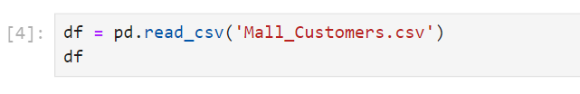
pandas : It provides structures like data frame for handling structured data
numpy : Provides support for numerical operations and working with arrays.
matplotlib: Used for creating static and interactive visualizations in Python.
seaborn : Built on top of matplotlib which is used for visualization
Step 4 : LOADING OF DATASET
we load the dataset Mall_Customers to the notebook

Slide 17
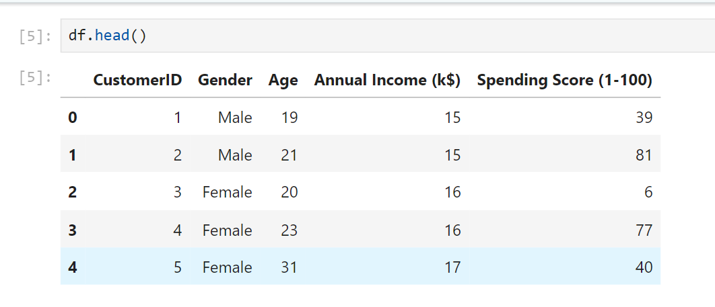
Step 5 : data preprocessing
Data Overview
To understand dataset structure and to check whether the dataset is loaded, we take few rows from the Mall Customers.
It will load the first 5 data. Here we take these 5 because viewing all will be time consuming , taking first 5 columns will give manageable glimpse of data. Also head() in python or R display first 5 by default, making it a standard practice for initial exploration.

Slide 18
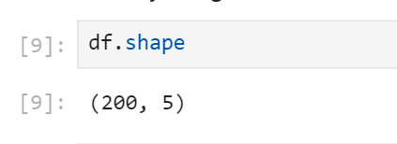
b) Dataset shape
To understand the number of rows and columns. The dimension of our dataset is checked
From this we understood thar our dataset is consist of 200 columns and 5 rows

Slide 19
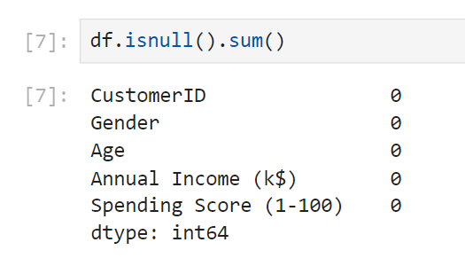
c) Checking for the missing values
It is a very important step. If missing values are not handled carefully, they may result in an incorrect prediction. This can be handled by deleting the row or by calculating the mean of the row or column where the values are missing
The result shows that there are no missing values in the dataset. This confirmed that further data cleaning is not required for missing values.

Slide 20
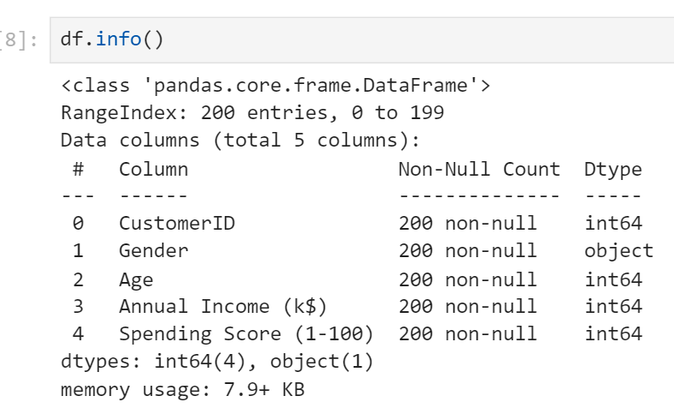
d) Data Information
The dataset information is required to check the datatypes of each column and number of non-null values in each.
From the result , we understood that the dataset is stored efficiently with numeric variables as integers and categorical data(gender) as an object(string). This ensures the data is ready for further analysis.

Slide 21
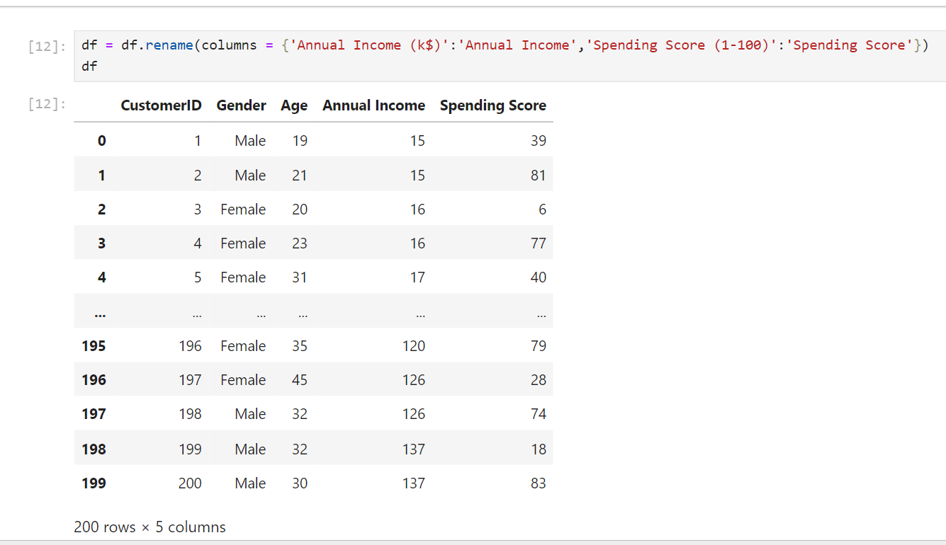
Data Renaming
Here we renamed the columns “Annual Income(k$)” and “Spending Score(1-100)” to Annual Income and Spending Score for easy preference.

Slide 22
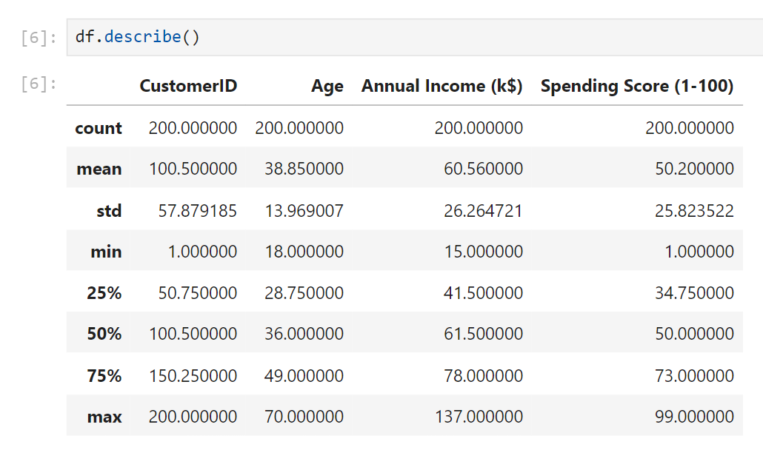
Step 6 :Exploratory Data Analysis (EDA)
Summary statistics

Slide 23
Here we generated summary statistics of the dataset . It describes about the count which counts the no of rows in it, mean of the columns, standard deviations, maximum and minimum and percentiles etc. From the statistics
The mean age of customers is 38.85 years.
The average annual income is $60.56k
The average spending score is 50.20

Slide 24
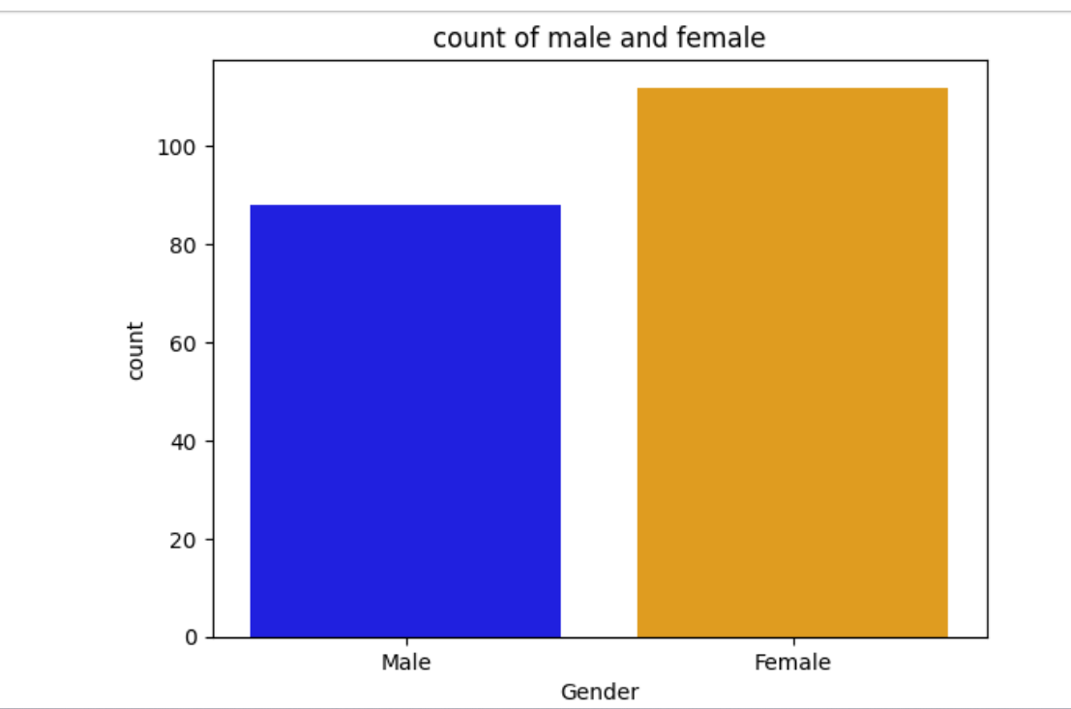
b) Gender Distribution
Now we can visualize and understand the distribution of customers by gender , for this count plot is used
It is observed that females purchases more than male customers.

Slide 25
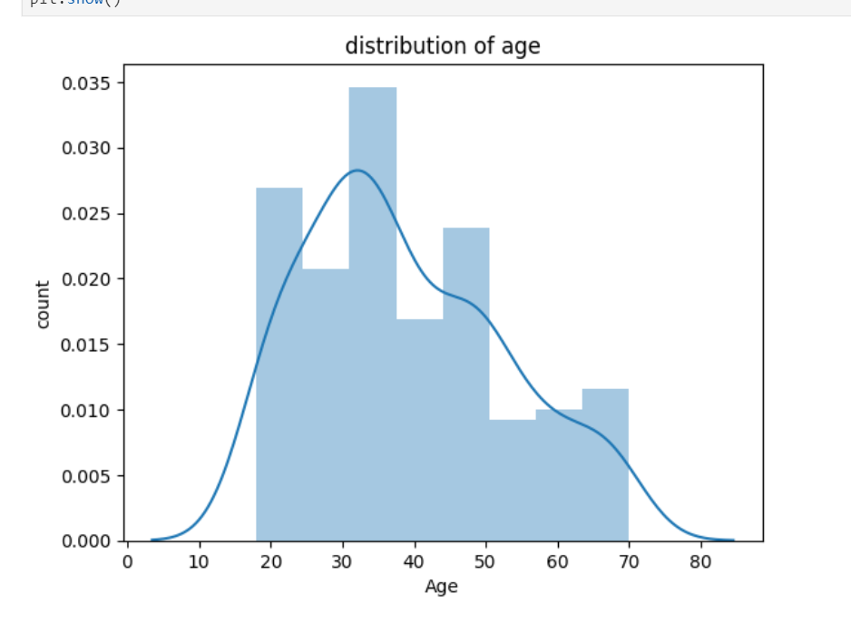
c) Age distribution
Here we used distplot to analyze the distribution of age in customers. It is clear that the age varies from nearly 20 to 70 years. The highest count indicates that customers between the age group 30-40 years are more . Our customers are young or middle aged. Here the plot is right-skewed which means more young customers than older customers.

Slide 26
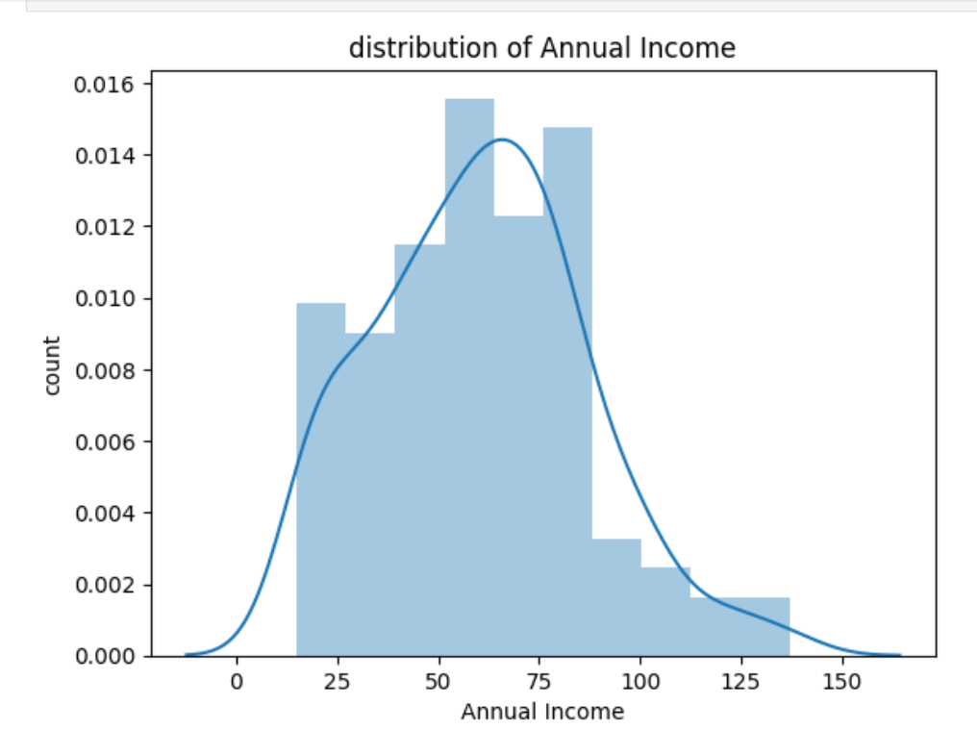
d) Annual income distribution
From the plot, the income varies from nearly 25 to 125 k$. The highest count indicates that common income of majority of customers is 50k$ . Here the plot is right-skewed which means most of them have lower or moderate income and some of them have higher income.

Slide 27
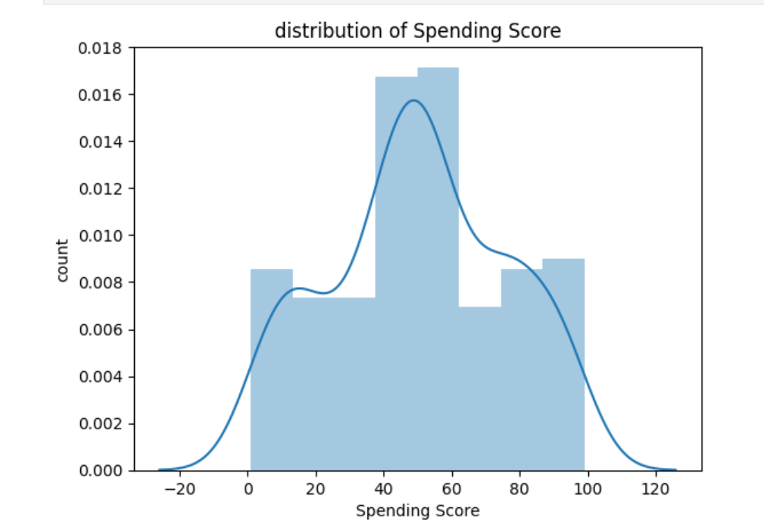
e) Spending score distribution
From the plot, the spending score ranges from 0-100. The plot shows a significant number of customers have spending scores between 40 and 60, which means that many customers fall within this behaviour category. In this plot fewer customers have either very low(below 20) or very high spending score(above 100).

Slide 28
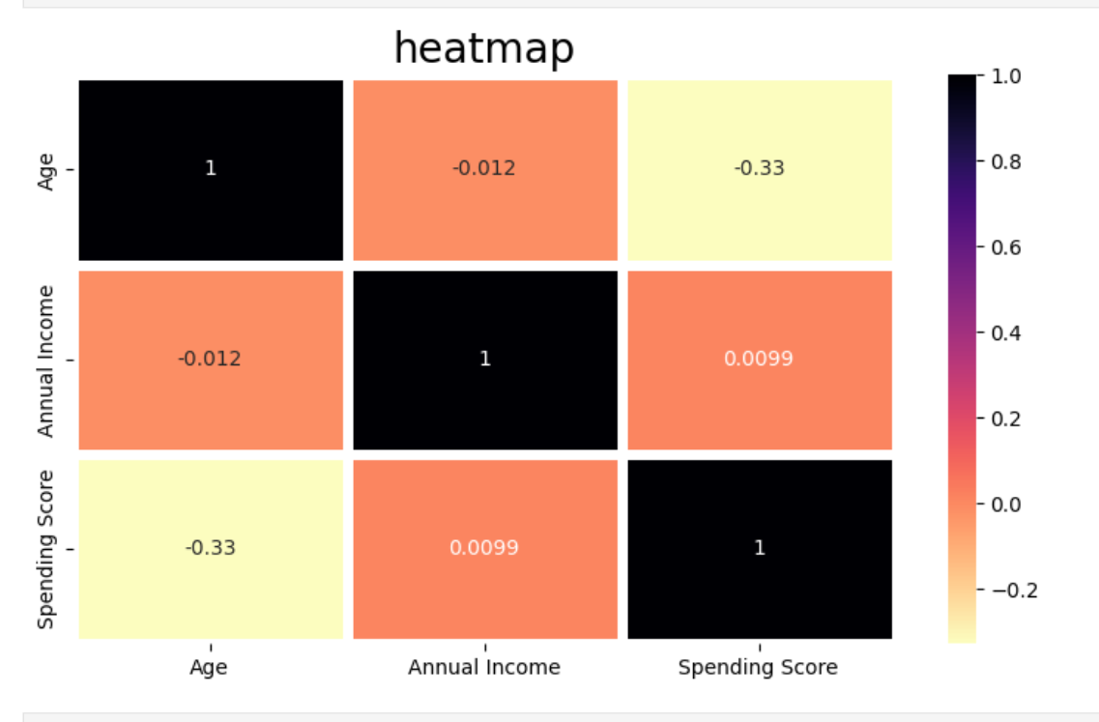
g) Correlation Analysis
A correlation matrix is a table showing correlations between variables. A heatmap is generated to visualize a correlation matrix to observe the correlation between Age, Annual Income, and Spending Score, indicating which variables are most related.
Based on correlation analysis , we get annual income and spending score correlates to each other with a good score.

Slide 29
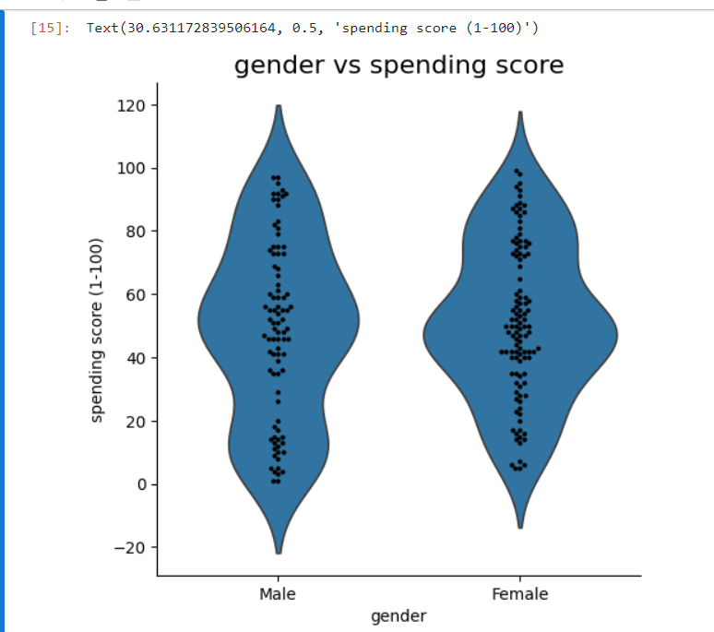
h) Comparison between Gender and Spending Score
To understand the difference in spending score between male and females, we generate a violin plot .
From the plot it clear that females have more spending score than males. That is females spends more in purchasing than men.

Slide 30
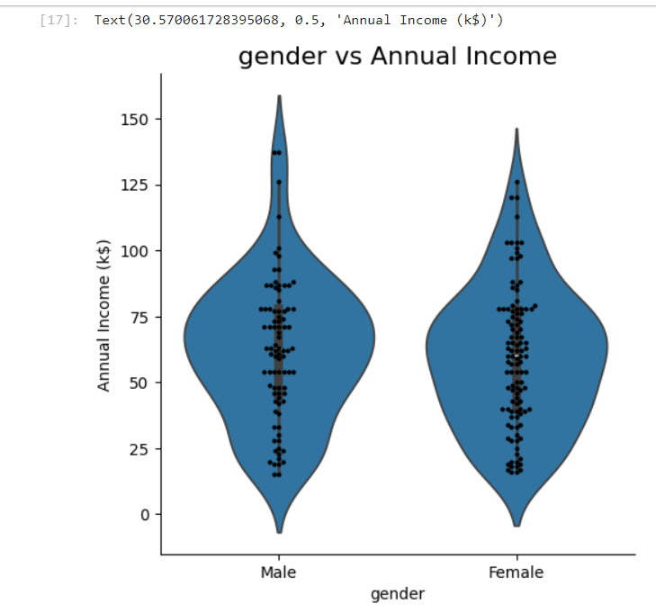
i) Comparison between Gender and Annual Income
Violin plot is used to compare the distribution of different numerical features across customer segments. The plot shows males have more annual income than female. Which means the salary of male is higher than that of female.

Slide 31
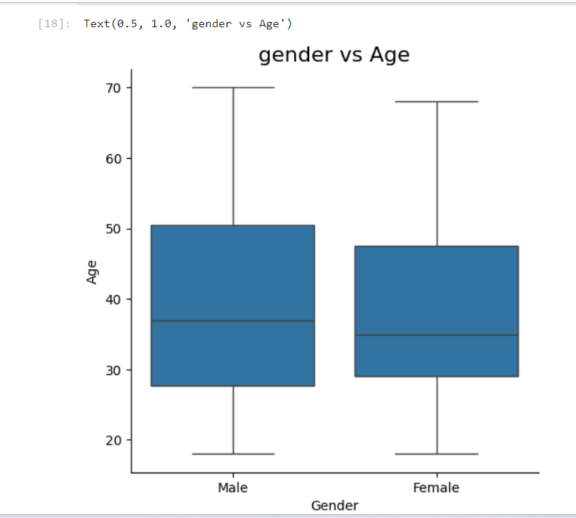
J) Comparison between Gender and Age
To understand the relationship between gender and age we use box plot. A box plot, also known as a whisker plot, provides a summary of the data's five-number summary: minimum, first quartile (Q1), median, third quartile (Q3), and maximum.

Slide 32
In the plot the median is quite similar for male and female (35-40 years) . The interquartile range of both gender are around in 30-50 years range. The maximum and minimum for both customers are 20 and 70 years.
Thus it is clear both genders have same age distributions with no major difference in their range and median. Since most of the customers fall within 30-50 years age group for both men and women. It means that this age group is making most purchases in both genders.

Slide 33
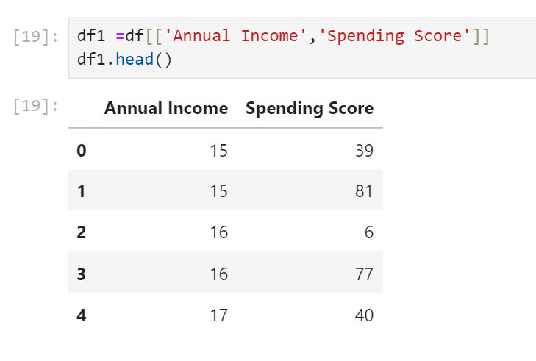
Step 7: clustering process
Clustering With 2 Features
a) Feature selection
Feature Selection is a critical step in identifying
the most relevant variables that contribute to
Customer segmentation process.
Here for clustering we select Annual Income &
Spending Score as 2 features.

Slide 34
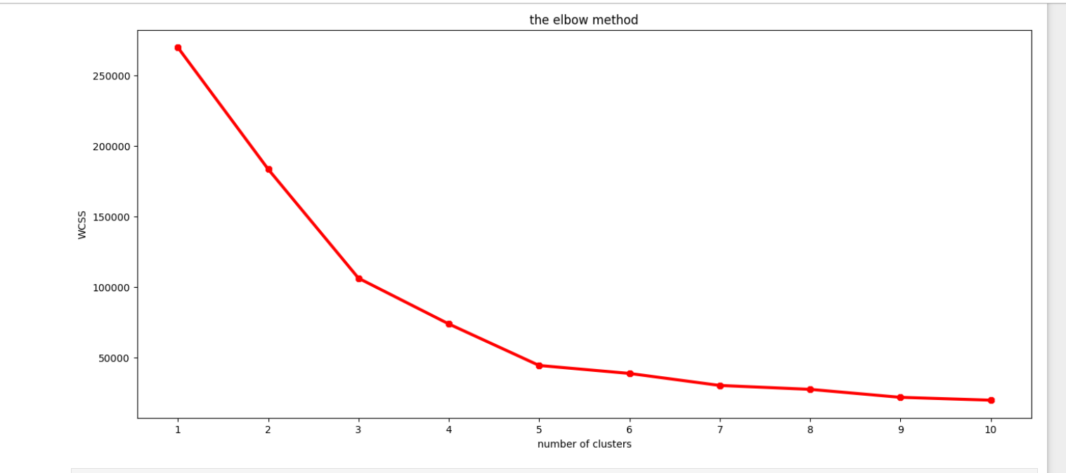
b) Determining the optimal number of clusters
The WCSS is calculated for different values of k (number of clusters). The Elbow Method was applied to determine the optimal number of clusters by plotting the WCSS. The point where the WCSS begins to decrease at a rate is chosen for the optimal number of cluster for segmenting the data.
From the graph it is observed that at 5 there is a bend and it can be considered as K , which is no of clusters

Slide 35
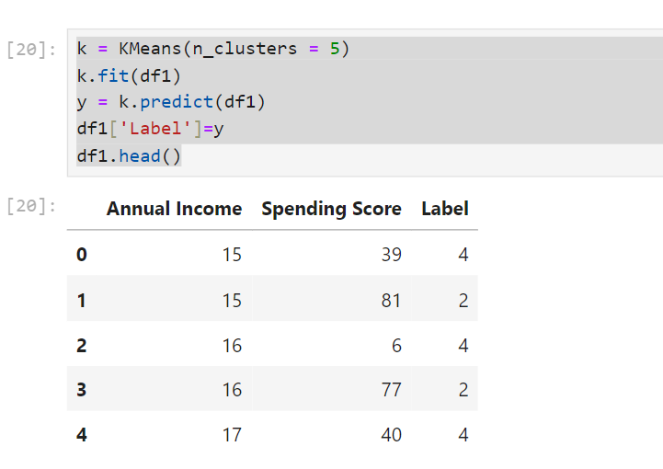
c) Applying K-Means Clustering
After determining the optimal number of clusters is
determined next we apply k-means algorithm to customers
into distinct clusters based on selected features. Then we
Will predict the data and will store it in y & then we will
Add new column named as Label and data as y.
It is seen that after k-means algorithm the dataset was
updated with a New column “Label” which indicates the
cluster labels for each cluster.

Slide 36
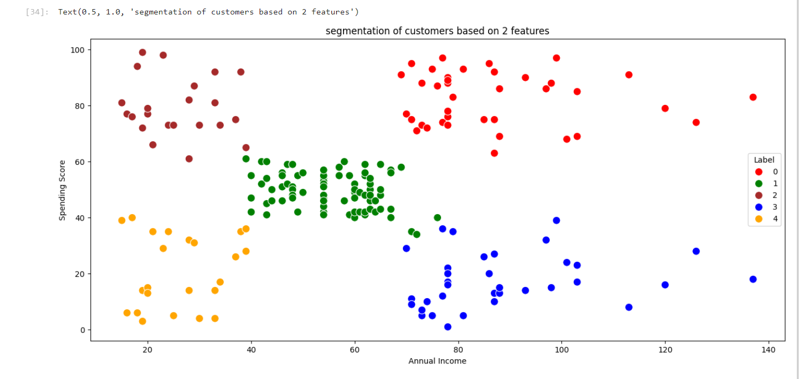
d) Visualization
To visually interpret the clusters , a Scatter Plot is generated with the features Annual Income and Spending Score with each point color-coded by its assigned cluster label . This helps in visualizing the separation between different customer segments.

Slide 37
Observations of scatter plot
So from the above scatter plot we observed that the there are 5 clusters which are named as 0, 1, 2, 3, 4.
Label 0 at top right indicates highest annual income with highest spending score
Label 1 at centre of the plot indicates average annual income with average spending score.
Label 2 at top left of the plot indicates lowest annual income with highest spending score
Label 3 at bottom right indicates highest annual income with lowest spending score.
Label 4 at bottom left indicates lowest annual income with lowest spending score.

Slide 38
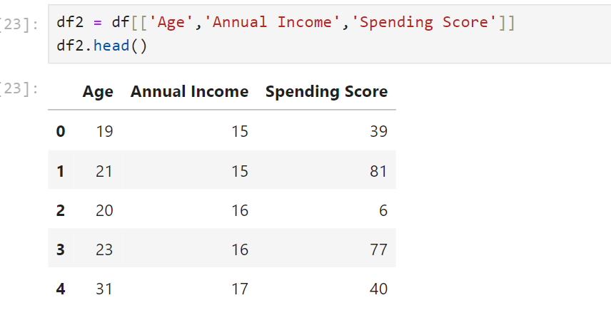
2) Clustering with 3 features
a) feature selection
For this we select annual income , spending score, age as 3 features

Slide 39
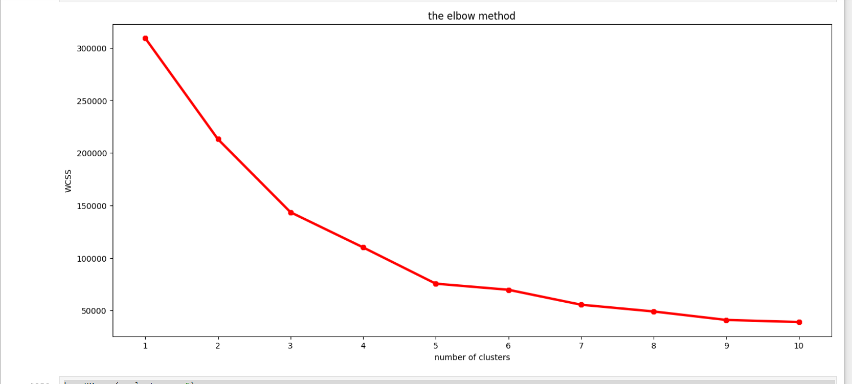
b) Determining the optimal number of clusters
Here k= 5 . The optimal cluster is still 5

Slide 40
c) Applying k-means clustering

Slide 41
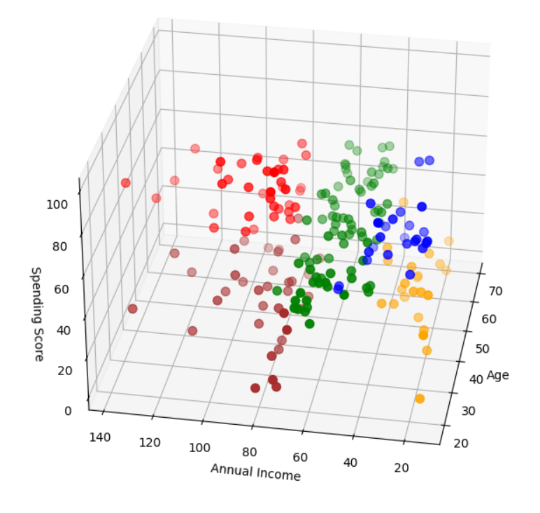
d) Visualization
To interpret clusters ,a 3D scatter plot
Is generated with each color-coded by
Its assigned cluster label.
In this plot, each axis represents one of
the selected features .this 3D plot helps
In identifying how customers with similar
Income, spending behaviour and age
group together.

Slide 42
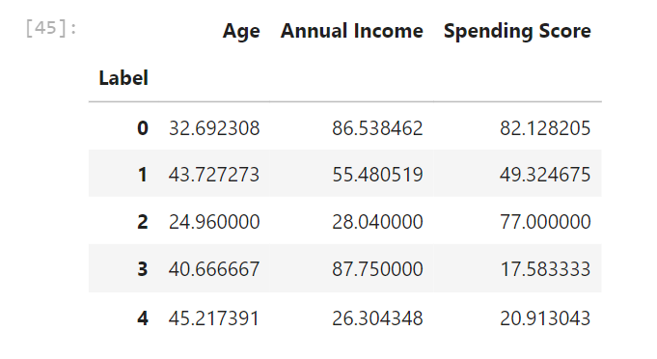
Observations of 3D scatter plot
In the 3D plot we observe that there are 5 clusters. To understand what each clusters interpret we performed a mean analysis of the above features.

Slide 43
From the result we get 5 clusters as:
Label 0 indicates that highest annual income with highest spending score and age may indicate young clusters.
Label1 indicates that moderate income with average spending score and they are middle-aged customers.
Label 2 indicates low annual income with high spending score and they are younger customers .
Label 3 indicates high income with low spending score and they are middle-aged customers.
Label 4 indicates low annual income with low spending and it mainly consists of middle-aged or older customers.

Slide 44
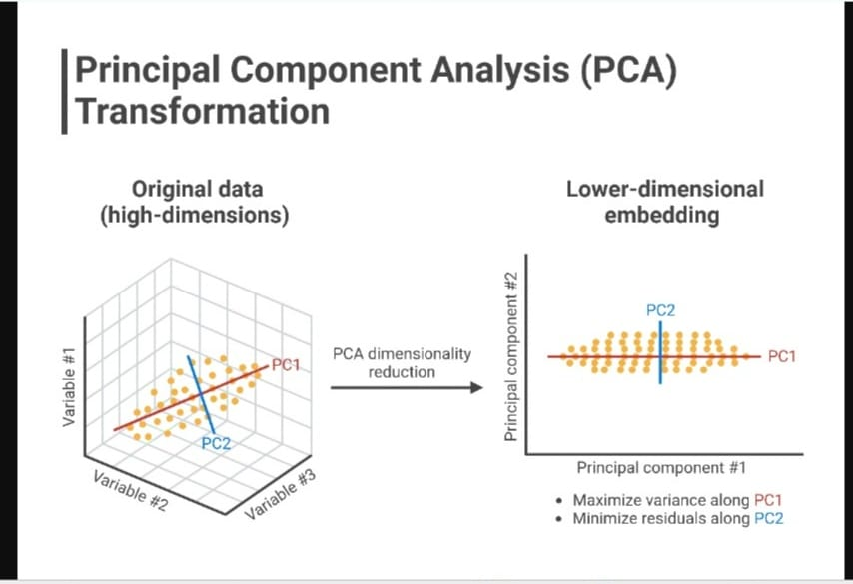
For better visualization we use PCA plot which is similar to 2D scatterplot.
Principal Component Analysis is a statistical procedure that uses an orthogonal transformation that converts a set of correlated features to set of linearly uncorrelated features. These new transformed features are called principal components.
PCA is unsupervised learning algorithm
used for dimensionality reduction in ML.
It is technique to draw strong patterns
from the given dataset by reducing
variance. It drops the least important and
contains high important variables.

Slide 45
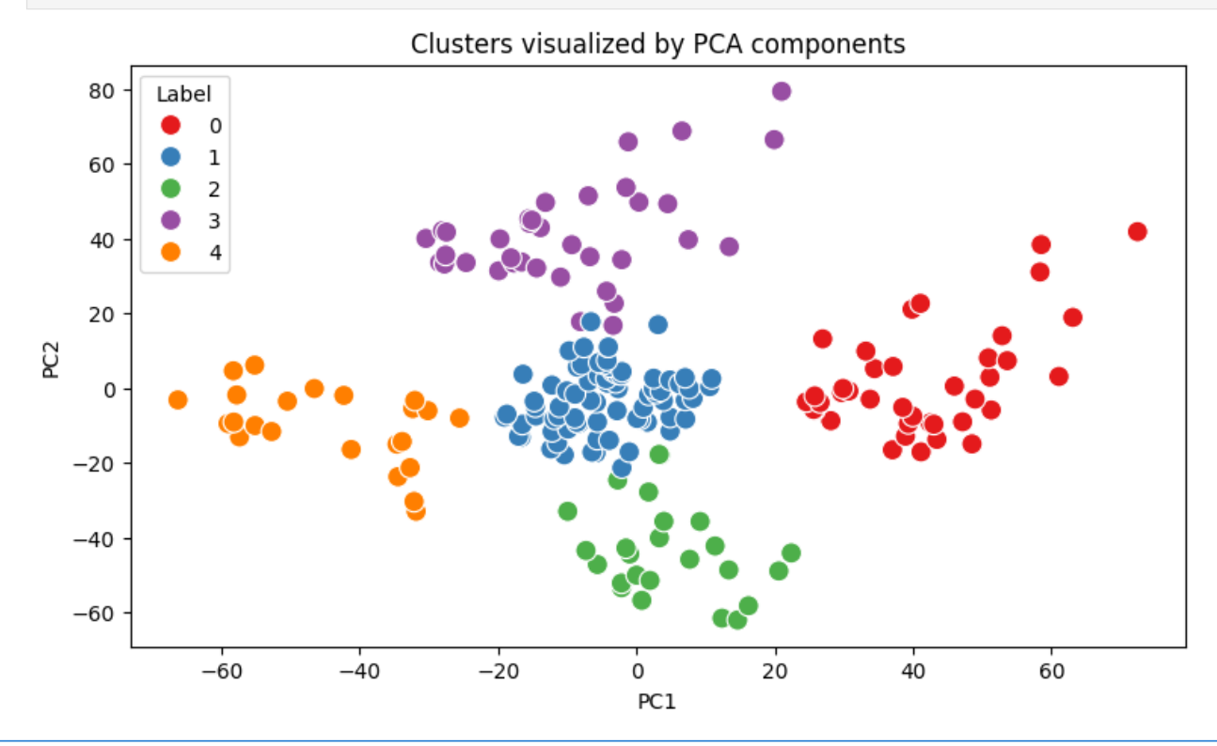
Observations of PCA plot
Red cluster is similar to Label 0 of 3D plot
Blue cluster is similar to Label 1 of 3D plot
Green cluster is similar to label 2 of 3D plot
Purple cluster is similar to Label 3 of 3D plot
Orange cluster is similar to Label 4 of 3D plot
From the plot PCA1 ranges from -60 to 60 and
PCA2 ranges from -60 to 80. We can interpret
these clusters based on mean analysis performed.
This provides simpler representation compared to
3D scatter plot

Slide 46
Result
From above 2D and 3D scatter plot and also PCA plot it is clear that Annual Income and Spending Score are the primary drivers in defining customer segments.
Age can be helpful as secondary factor to further understand the customer but doesn’t have impact on segmenting
The feature Annual Income was chosen as it represents the financial capability of customers. income levels often correlate with purchase making it a key factor indistinguishing between different customer segments.
The spending score is a valuable measure of customer behaviour ,reflecting how much customers tend to spend. The feature is essential in distinguishing between high spending & low spending, which is important for creating segments.

Slide 47
conclusion
Summary Of Insights
after performing clustering
The Highest income , high spending are the premium customers with both financial means and willingness to spend. They are likely to look for quality and luxury products.
Highest income, low spending are the customers have high income and not willing to spend more. They may be focused on saving instead of spending
Average income, Average spending are the customers that are likely to be budget-conscious. They may need some push to increase their spending score.
Low income, High spending are the customers that are willing to spend but has low income. They may focus on good deals, quality and practically .
Low income, Low spending are the customers that are budget-conscious with limited disposable income. They may need some significant push to spend more, focussing on price over quality.

Slide 48
2) Recommendation
here we present our market strategies and our target customers.
From the above insights our main target customers for any business are usually the group high income with high spending.
Because this customers are willing to spend more, we target them to focus on premium products and luxury services.
The market strategy can be used for other groups like for high income and low spending customers we can provide long-term such as quality or investment opportunities. We target these customers by asking feedback and advertising the product in a better way.

Slide 49
Low income and high spending can be targeted . We can use promotional strategies that will reward customers for continued engagement( like cashback offers)
Average income and average spending may or may not beneficial to the mall owners .we can encourage them for more purchases by promotions , discounts and bundle of offers.
In low income and low spending group market don’t target these type of customers because they earn little and spent little amount of money. For these type of customers we can provide budget-friendly products , flexible payment options. Focus on essential items they need rather than luxury or non-essential products.

Slide 50
3) Limitations
Fixed number of clusters: K-means requires the user to predefine the number of clusters K which may not be optimal without prior knowledge
Assumption of spherical clusters: K-means assumes clusters are spherical and equally sized, which doesn’t work well with non-spherical or unevenly distributed data.
Not robust to outliers: Outliers can significantly distort clusters centres, affecting the quality of the clustering.
Only works with numerical data: K-means uses distance measures, so it is not suitable for categorical data or mixed-type data without preprocessing.
Sensitivity to scale: If the features have different scales, k-means can be biased toward the features with larger ranges, requiring normalization or standardization.

Slide 51
4) Future Work
While the current analysis has successfully segmented customers based on available data, there are several opportunities to extend and enhance this work. By addressing certain limitations and exploring additional methods ,future research can provide deeper insights and further improve the effectiveness of customer segmentation.
You can explore advanced clustering techniques like DBSCAN, hierarchical clustering or Gaussian Mixture Models to improve segmentation quality ,especially for non-spherical clusters. Also this method is useful in deciding the number of clusters as no need to predefine K.
Future work could include additional features like location , product preference. These additional features would refine the segmentation providing deeper insights and enabling more precise targeting strategies.

Slide 52
Incorporating behavioural data such as purchase frequency, types of products brought or browsing history would allow for more understanding of customer segmentation. This could lead better tailored marketing strategies that address specific behaviours rather than just demographic attributes.
Incorporating customer feedback and satisfaction scores could provide valuable insights into the quality of service or product perferences. This data could be used to segment customers based on how they perceive the business, allowing more customer-centric improvements.

Slide 53
References
Sari Juni Nurma, Nugroho, Lukito. Edi, Ferdiana, Ridi & Santosa, P. Insap (2016).“Review on Customer Segmentation Technique on Ecommerce”. Advanced Science Letters, vol 22, No(10), 3018–3022.
Chenguang Wang (2022).”Efficient Customer Segmentation in digital marketing using Deep Learning with Swarm Intelligence Approach”. Information Processing and Management, vol 59, issue 6, 0306-4573.
Rahma Wah Sembring Brahama, Fahd Agodzo Mohammed, Kankamol Chairuong (2020).”Customer Segmentation based on RFM model using K-Means , K-Medoids and DBSCAN methods”. Lontar Komputer Jurnal Ilmiah Teknology Informasi, vol 11, 2541-5832.
Eman Hussein .Sharaf Addin, Novia Admodisastro, Siti Nur Syahirah, M. Ashri, Azrina Kamaruddin Yew C. Chong(2022). “Customer Mobile Behavioural Segmentation and Analysis in Telecom Using Machine Learning”. Applied Artificial Intelligence, vol 36, 2022, Issue 1

Slide 54
M. A. Syakar, B. K. Khotimah , EMS Rochman, B. D. Satoto(2018)”Integration K-Means Clustering Method and Elbow Method for identification of the best customer profile cluster”. IOP Conference Series: Materials Science and Engineering ,vol 336
Mediana Aryuni, Evaristus Didik Madyatmadja, Eka Miranda(2018) “Customer Segmentation in XYZ Bank using K-Means and K-Meiods Clustering”. International Conference on Information Management and Technology(ITCM Tech)
Jaypee University of Information Technology “Customer Segmentation.pdf “ (2022)
Customer Segmentation using K-Means Clustering with Python | Machine Learning Projects (2021)

Slide 55
THANK YOU

